Slide 1

SunTrac Design Team
02 March, 2020 - Northern Arizona University
Kadeja Alhossaini
Nathan Firor
Edwin Smith
Ethan Vieane

Slide 2
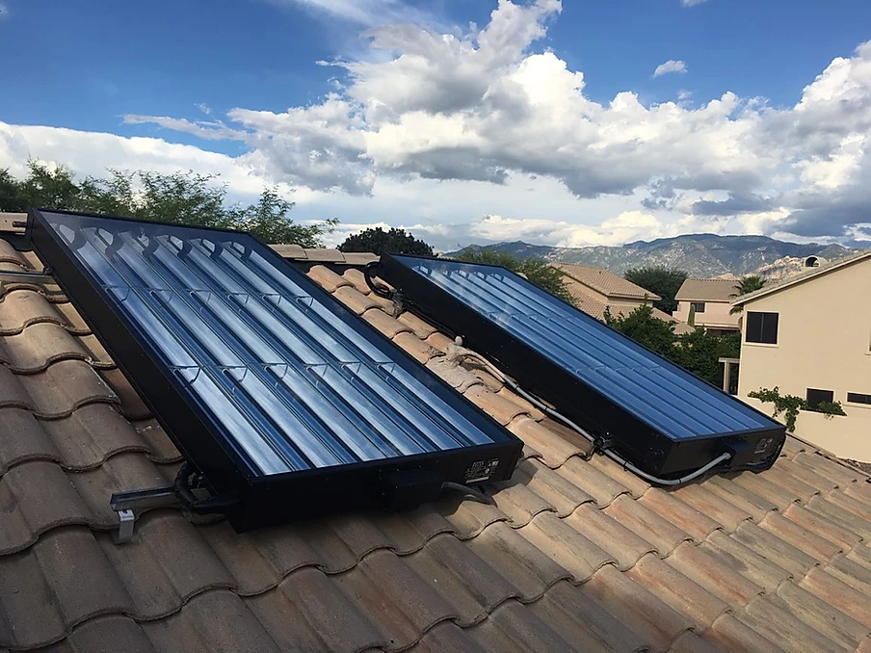
Project Description: The Client
Suntrac USA is a hybrid climate systems company
Based in Tempe, AZ
Manufacture a solar energy heat exchanger to be used in AC and HVAC systems
Thermal expansion boosts compression, and can save up to 40% in cooling related costs.
The arrays seen in Figure 1 utilize copper pipe manifolds to run refrigerant through
Figure 1: Suntrac Mirror Array [1]
Firor 1

Slide 3
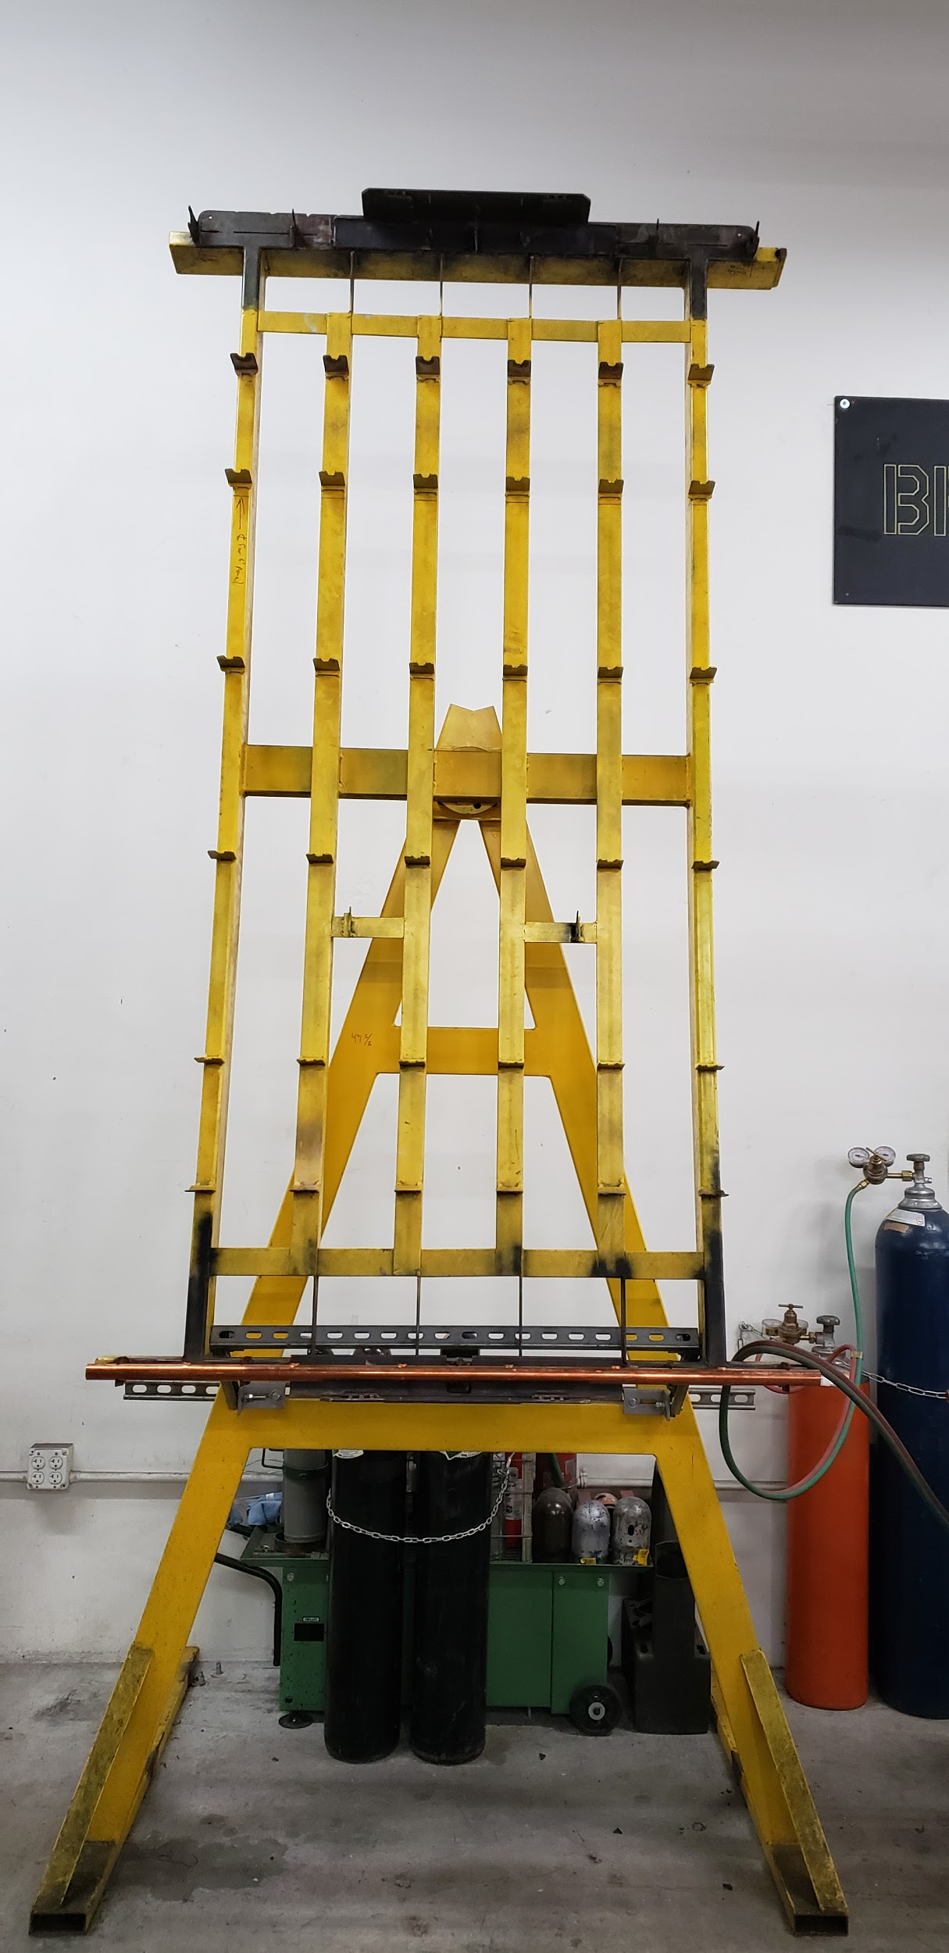
Project Description: The Task
The Jig employed aligns and secures the pipes to dimension while they are braze welded together
The task is to design a braze welding jig compatible with assembling
SunTrac’s 4’, 6’ and 8’ solar thermal pipe manifolds.
Provide a CAD package and complete assembly with detailed drawings
Create part lists, BOM, manufacturing and assembly details
Build a full scale and functional prototype
Figure 2: Current 8 Foot Manifold Jig
Firor 2

Slide 4
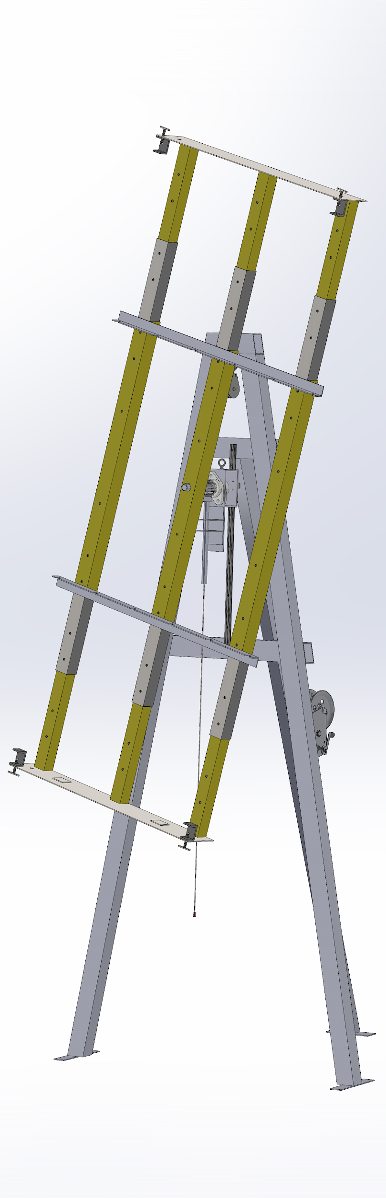
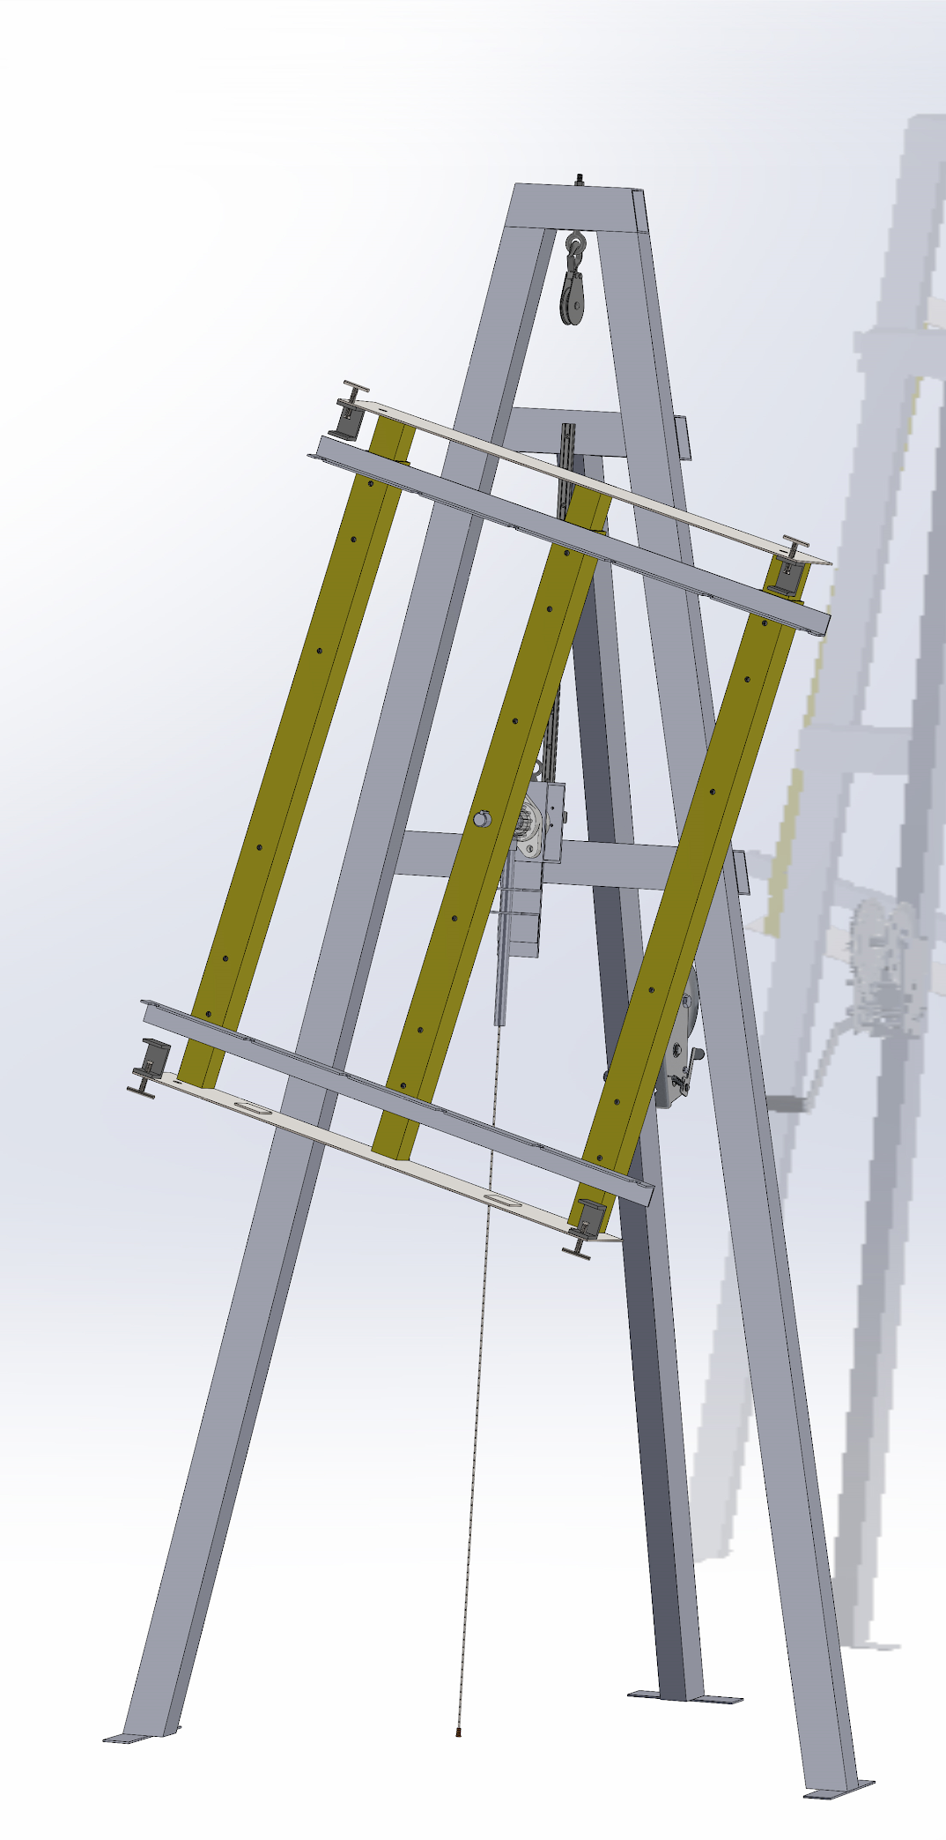
Design Description: CAD Model
Support Pulley
Aligning Standoffs
Telescoping Tubes
Locking/ Guide Rail Assembly
Securing Power Screws
Lock/ Unlock Cable
Structural Frame
Figure 3: 4 Foot CAD Configuration
Figure 4: 8 Foot CAD Configuration
Firor 3

Slide 5
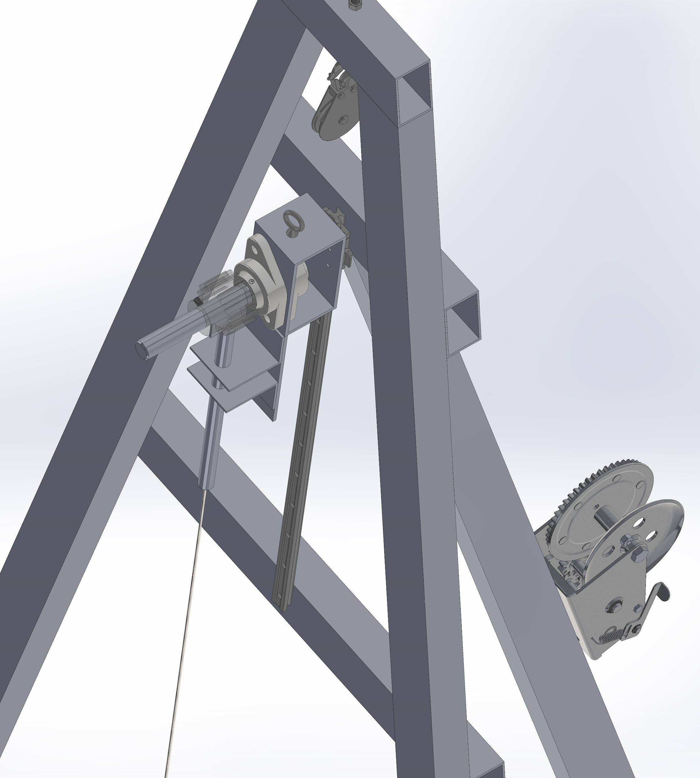
Design Description: Locking and Vertical Actuation
Cable Pulley
Allows for a 4 foot working height
Cable Eyelet
Bearings
Carriage
Gear
Interlocking Rod and Spring
Guide Rail
Lock/ Unlock Cable
Lifting Winch
Figure 5: Design Solution Detailed CAD
Firor 4

Slide 6
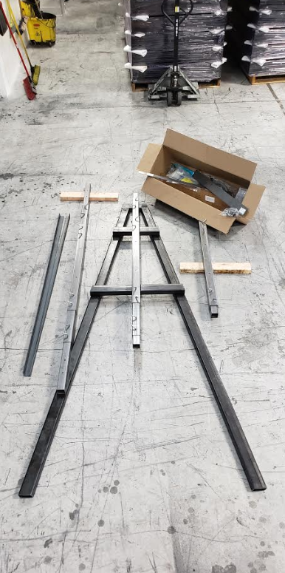
Current State of System
The current state of manufacturing:
All the stand pieces are cut to shape.
All the pieces of the jigs frame have been cut and the holes are drilled with the pins inserted.
Things left to do:
Assemble and weld the stand and frame together.
Assemble and weld the pulley, power screw, and locking mechanism.
Figure 6: Current State of Jig
Alhossaini 5

Slide 7
Current State of System
Engineering Requirements that have been met:
Melting Temperature (1400℃)- met by using material that withstands this temperature (Carbon steel).
Force to Rotate (13N) - met by using bearing that allows the Jig to be easy to operate but not unsafe.
Cost under $1,600- met through the BOM.
Number of Compatible Products (3) - met by using the telescoping tubes.
Standard Parts (90%) - most of the parts are bought from Mcmaster-Carr.
Footprint (5ft x 5ft) - met by designing the stand of the jig such that it keeps within that area.
Degree of Rotation (360 degrees) - met by using a gear to rotate the jig frame.
Number of Locking Positions (12) - met by using a gear with 14 teeth.
Engineering Requirements that have not been met:
Durability (5 yrs) - have yet to perform testing on the jig.
Tolerance/ Error (+/- 1/16”) - will be met by testing the telescoping tubes after their construction.
Alhossaini 6

Slide 8
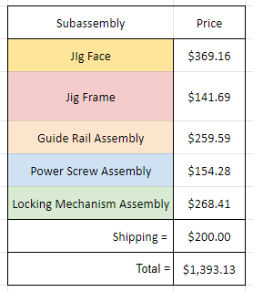
Current State of System
Bill of Materials (BOM) Breakdown:
All parts in the BOM are purchased and shipped to SunTrac.
A $30.00 will be added to visit Ace Hardware in person to get several bolts and nuts that are required in the assembly process.
Table 1. Simplified BOM
Alhossaini 7

Slide 9
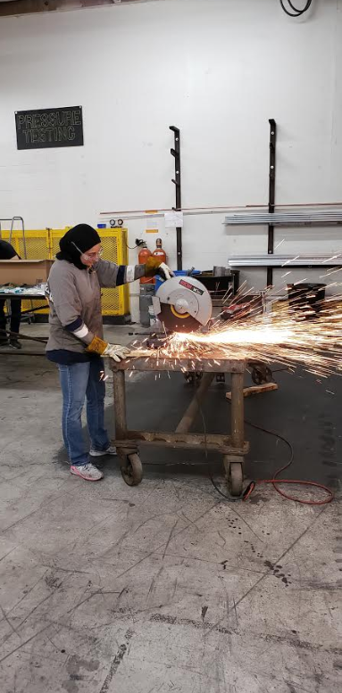
Current State of System
Completed action items by Team members:
Kadeja Alhossaini (Cutting Angles)
Figure 7: Cutting Angles on the Beams
Alhossaini 8

Slide 10
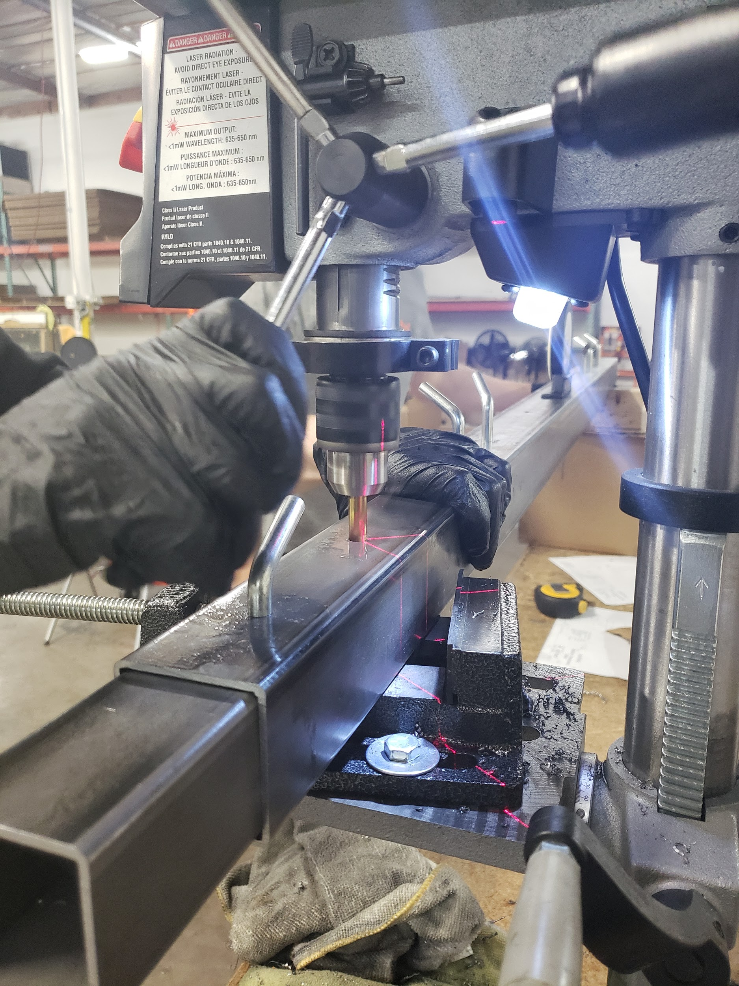
Current State of System
Completed action items by Team members:
Nathan Firor (Measuring and Drilling Holes on Jig Face)
Figure 8: Drilling Holes
Alhossaini 9

Slide 11
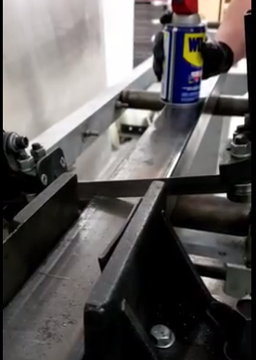
Current State of System
Completed action items by Team members:
Edwin Smith (Cutting Steel)
Figure 9: Cutting Steel Beams
Alhossaini 10

Slide 12
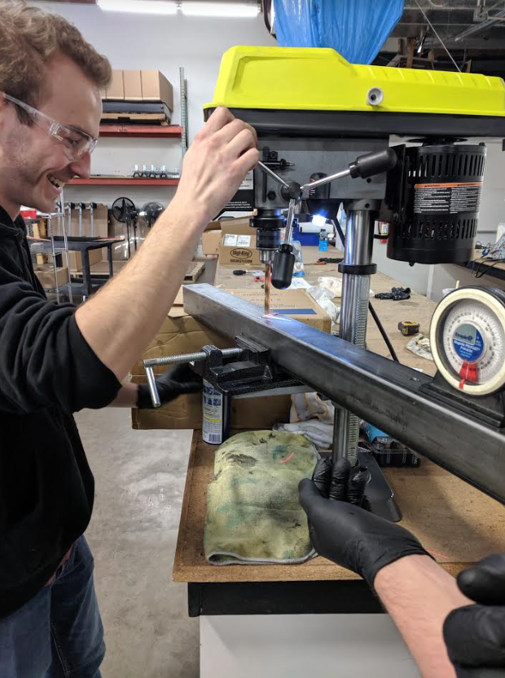
Current State of System
Completed action items by Team members:
Ethan Vieane (Measuring and Drilling holes of Jig Face)
Figure 10: Drilling Holes
Alhossaini 11

Slide 13
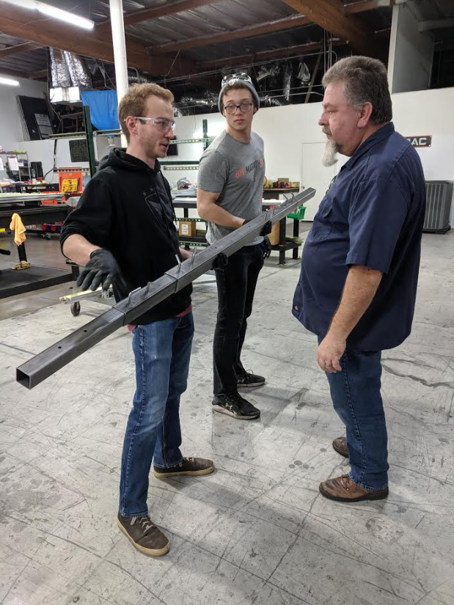
Implementation Plan
Manufacturing and design of the final product
Visit SunTrac USA’s manufacturing facility for three consecutive weekends (02/28 - 03/15)
Assign a list of objectives to be evenly distributed among the three weekends, ending with product completion
Divide each weekend’s workload evenly among the four members
If possible, shift tasks ahead to finish early to reserve more time for testing procedures and as a contingency plan for unexpected revisions
Consult client (Stu Siebens / SunTrac managers) about on the spot revisions
Figure 11: Discussions with Supervisor
Smith 12

Slide 14
Implementation Plan
Manufacturing Plan
Week One:
Cut all Jig Frame steel beams to length
Cut all Jig Frame angles
Measure and drill all telescoping tube pin holes
Figure 7: Cutting Angles on the Beams
Smith 13

Slide 15
Implementation Plan
Manufacturing Plan
Week Two:
Drill holes for all Jig Frame and Locking Mechanism bolt connections
Drill holes for Power Screw subassembly and Jig Frame angle irons
Consolidate unassembled subassemblies and evaluate part positioning steps forward
Bolt together Jig Frame and Locking mechanism subassemblies
Weld together Telescoping Tubes, End Plate, and Power Screw subassemblies
Figure 6: Current State of Jig
Smith 14

Slide 16
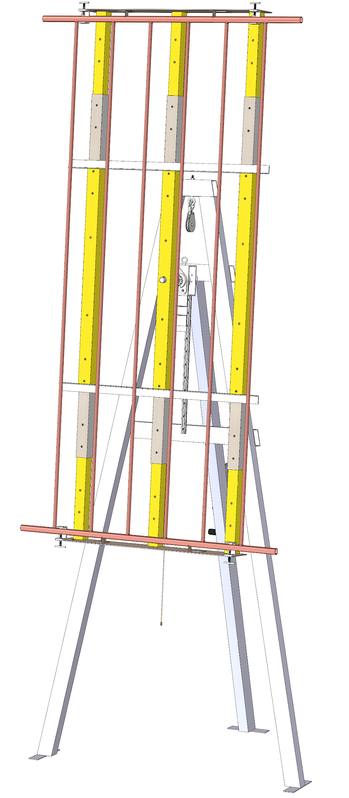
Implementation Plan
Adjustable for 3 Size Variations
Manufacturing Plan
Week Three:
Attach constructed Jig Face to the shaft of the Locking Mechanism to finalize product
Perform testing procedures on site
Auto- Locking Winch and Pulley
Rotation Safety Lock
Open skeletal design for accessibility
Rugged, High Heat Allowing Frame
Figure 12: Design Features
Smith 15

Slide 17
Implementation Plan
Upcoming Tasks
Hardware Review 2:
Edwin, Kadeja: Jig Frame, Locking Mechanism, and Guide Rail final design / construction
Ethan, Nathan: Telescoping Tubes, End Plate, and Power Screw final design / construction
Draft of Poster:
Edwin, Ethan: Abstract and results
Kadeja, Nathan: Methods and conclusion
Smith 16

Slide 18
Implementation Plan
Upcoming Tasks
Website Check:
Kadeja: All
Testing Proof:
Ethan, Kadeja: Critical length, Final Dimensions, and Final Cost TP’s
Edwin, Nathan: Heat Exposure and Rotation Assessment TP’s
Smith 17

Slide 19
Testing Plan
Testing Procedure 1: Critical Length
  ER’s Tested: Tolerance/Error, Number of Compatible Products, Degree of Rotation
Testing Procedure 2: Heat Exposure
  ER’s Tested: Melting Temperature, Durability
Testing Procedure 3: Final Cost
  ER’s Tested: Cost Requirement, Standardized Parts
Testing Procedure 4: Rotation Assessment
  ER’s Tested: Force to Rotate, Number of Locking Positions
Final Dimensions
  ER’s Tested: Footprint
Vieane 18

Slide 20
Testing Plan (Resources)
SunTrac Manufacturing Facility
  Oxy-Acetylene Torch
  Tape Measure
  Calculator
  Force Gauge
  Temperature Sensor
Completed Braze Welding Jig
Stu Siebens (SunTrac Representative)
Vieane 19

Slide 21
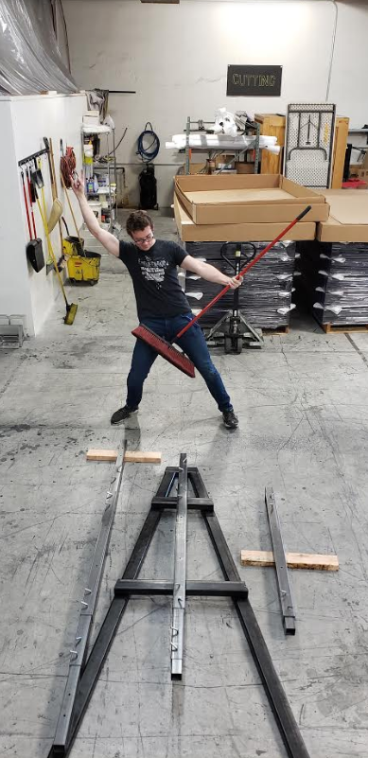
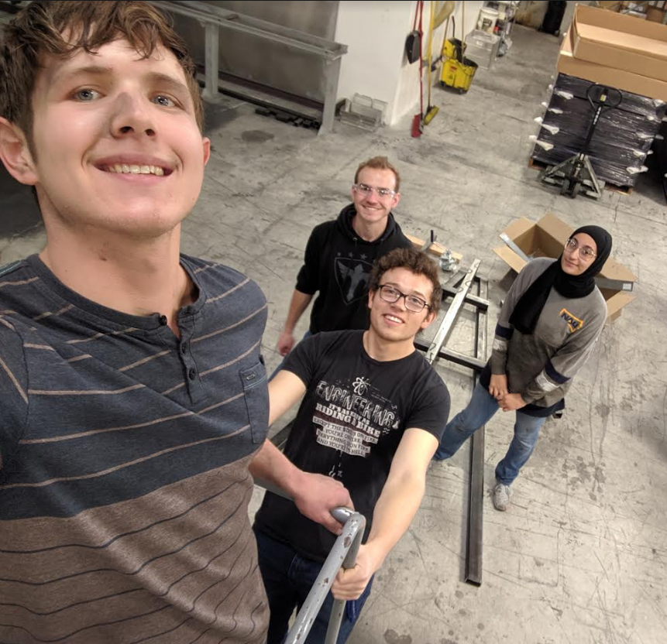
Questions?

Slide 22
References:
[1] https://www.suntracusa.com/gallery
Vieane #

Slide 23
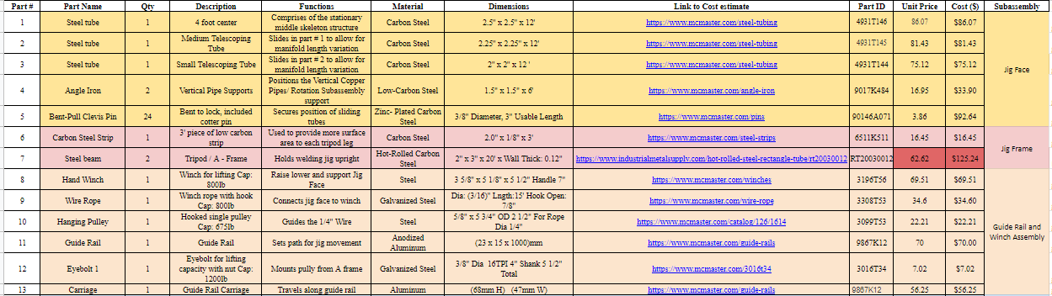
Appendix A: Bill of Materials Part 1
Alhossaini #

Slide 24
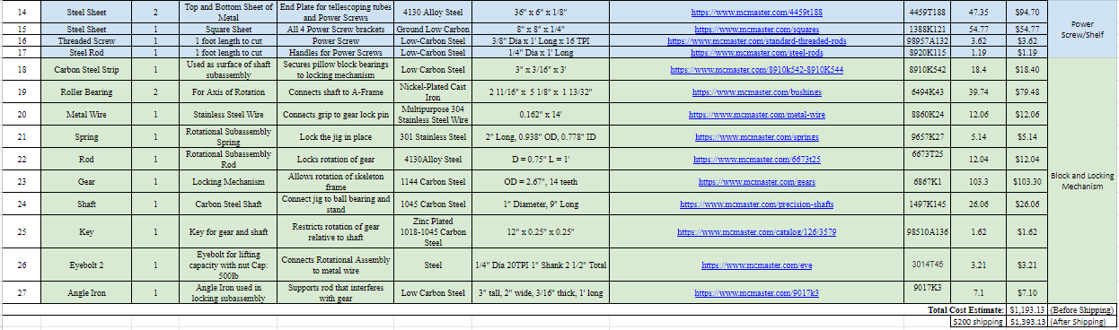
Appendix A: Bill of Materials Part 2
Alhossaini #

Slide 25
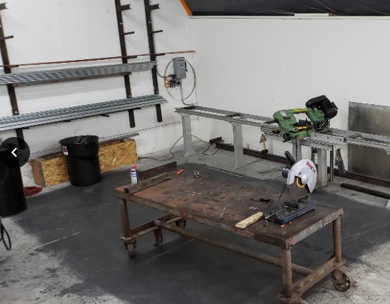
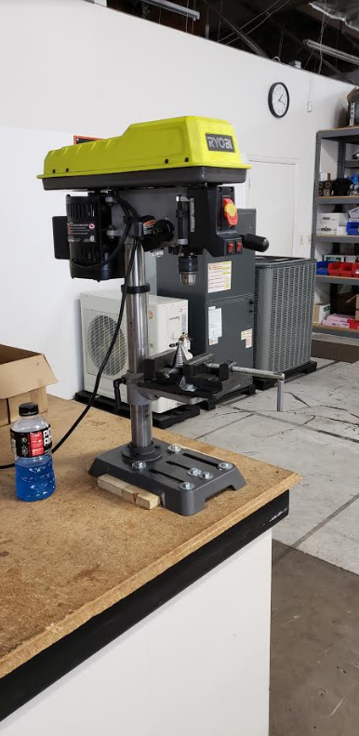
Appendix B: Pictures
Vieane #

Slide 26
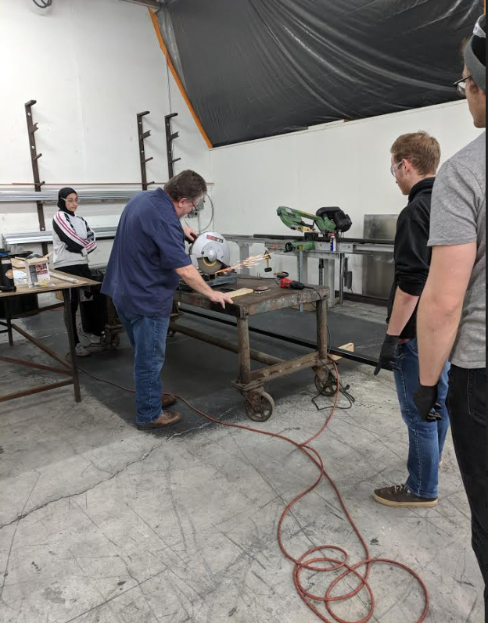
Appendix B: Pictures

Slide 27
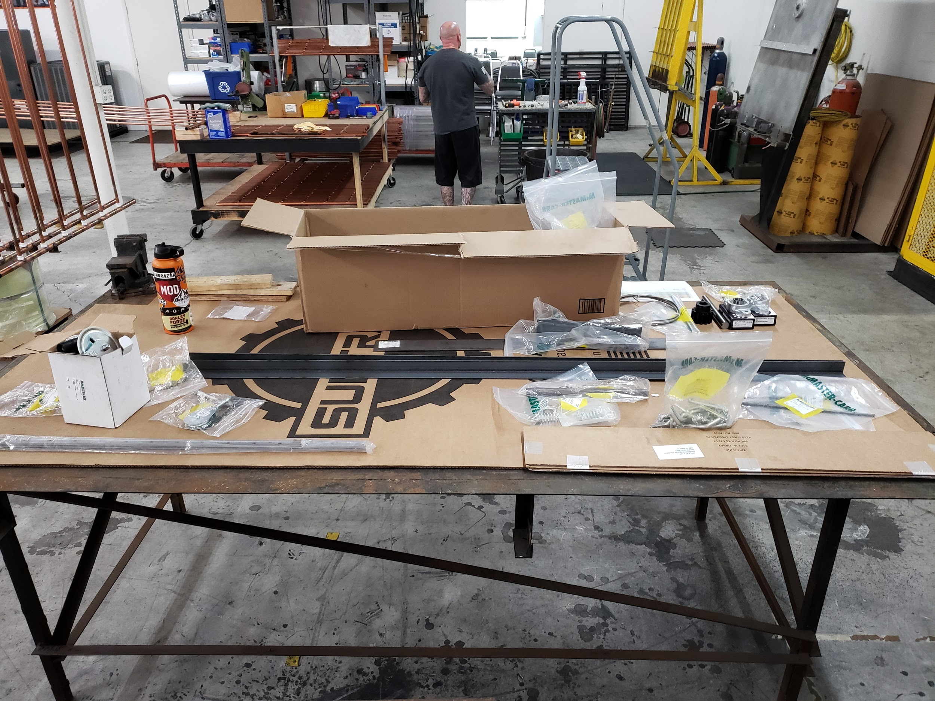
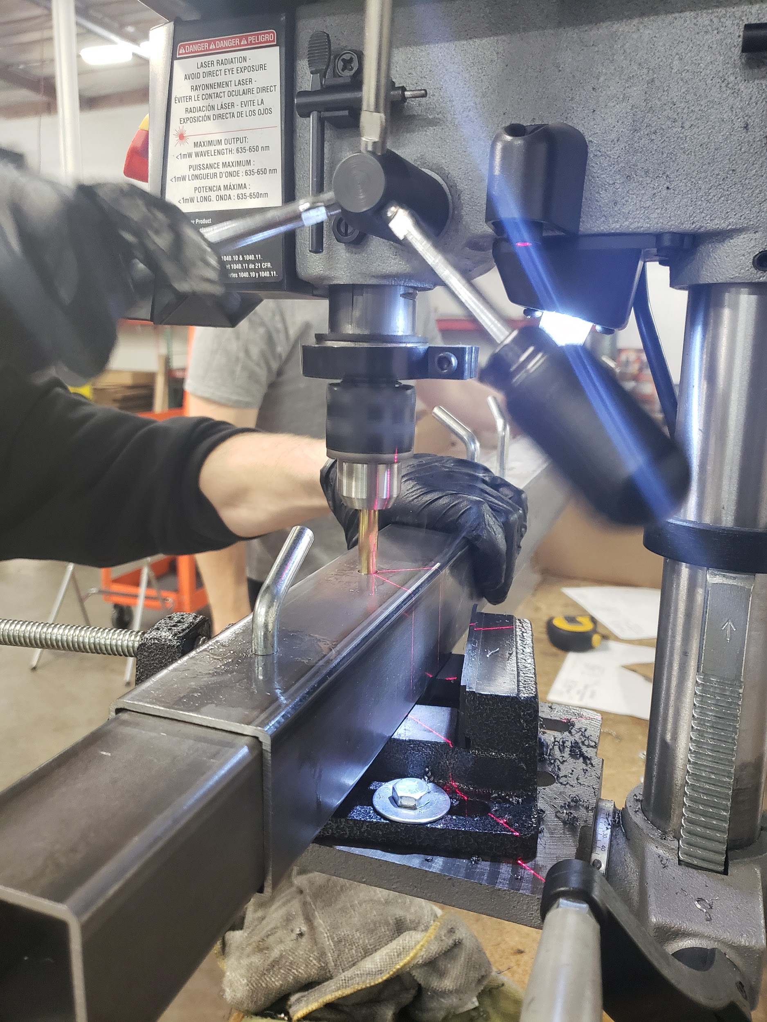
Appendix B: Pictures

